Slide 1
The TCA Cycle and the ETC

Slide 2
Pyruvate Transport and Oxidation

Slide 3
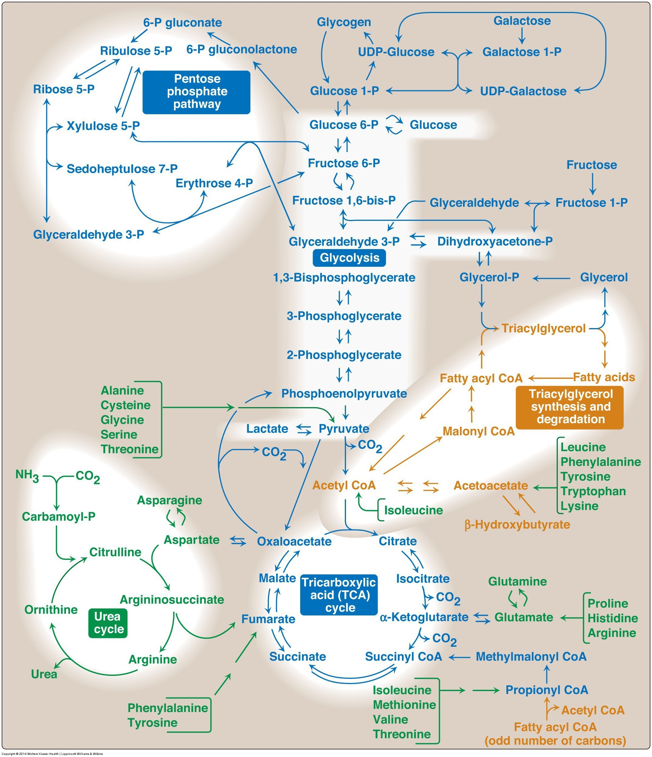
Fates of the Pyruvate from Glycolysis
Aerobic Conditions
Becomes Acetyl-CoA
In presence of CHO but need energy -> TCA Cycle
In presence of CHO but don’t need energy -> Lipids
In absence of CHO (relevant for lipid oxidation)
Ketone Bodies (if OAA absent)
Gluconeogenesis (if OAA present)
Anaerobic conditions
Becomes lactate
Lactate goes to liver for reconversion back to glucose
Notes:
Absent of CHO is mo

Slide 4
Lactate Dehydrogenase
Notes:
Mention what NADH is

Slide 5
What is a NADH (or a FADH2 or a NADPH)

Slide 6
Pyruvate Oxidation Occurs in Mitochondria
All three of the next steps are mitochondrial
Pyruvate Oxidation
TCA Cycle
Electron Transport Chain
Pyruvate needs to be transported into mitochondria

Slide 7
The mitochondria is the powerhouse of the cell
Notes:
Mention the radiolab podcast

Slide 8
The number of mitochondria per cell can be modified

Slide 9
Pyruvate Dehydrogenase
Making acetyl-CoA

Slide 10
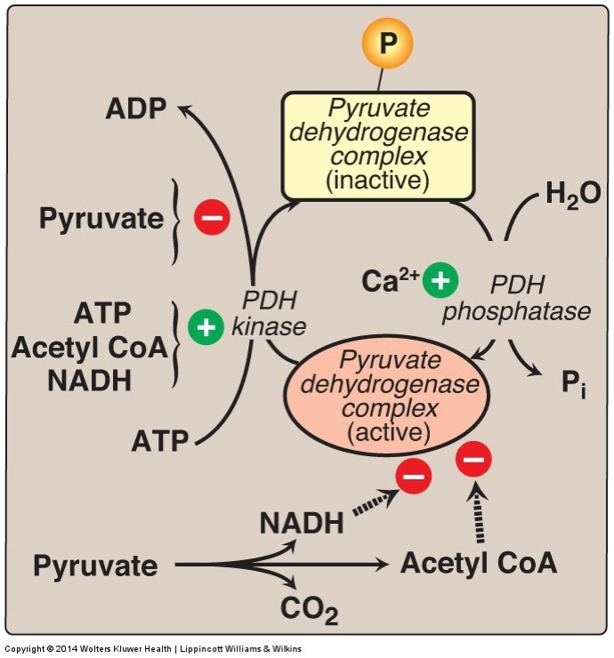
How is the decision made whether pyruvate should become Lactate or Acetyl-CoA
Allosteric regulators
NADH
Acetyl-CoA
Through Phosphorylation and inactivation by PDH Kinase
ATP
NADH
Acetyl-CoA
Pyruvate

Slide 11
Wernicke-Korsakoff Syndrome
Thiamine (Vitamin B1) is a cofactor for PDH as well as some other enzymes
Ethanol inhibits thiamine uptake in GI system
A more minor deficiency is called Beriberi
Symptoms include
Lactic acid and pyruvate buildup
High output cardiac failure
Exercise intolerance
Neurodegeneration, numbness, poor reflexes

Slide 12
Acetyl-CoA can now go in several directions

Slide 13
The Fates of Pyruvate/Acetyl-CoA
Aerobic Conditions
Becomes Acetyl-CoA
In presence of CHO but need energy -> TCA Cycle
In presence of CHO but don’t need energy -> Lipids
In absence of CHO (relevant for lipid oxidation)
Ketone Bodies (if OAA absent)
Gluconeogenesis (if OAA present)
Anaerobic conditions
Becomes lactate
Lactate goes to liver for reconversion back to glucose

Slide 14
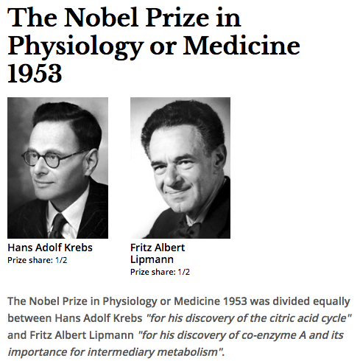
TCA Cycle
AKA Krebs Cycle
AKA Citric Acid Cycle

Slide 15
Simple View of the TCA Cycle
The outcomes of this reactions are
NADH and FADH₂ will be used in the electron transport chain
GTP can be interconverted to ATP
Both carbons that were part of Acetyl-CoA are now released as CO₂
Acetyl-CoA + 3 NAD⁺ + FAD + GDP + P_{i} + 2 H₂O | → CoA-SH + 3 NADH + FADH₂ + GTP + 2 CO₂

Slide 16
The TCA Cycle Releases Energy in the Form of Electron Carrier Molecules

Slide 17
The Regulated Steps of the TCA Cycle
Citrate Synthase
NADH, FADH₂, ATP
OAA, AMP
Isocitrate Dehydrogenase
NADH, ATP
ADP, Ca²
α-Ketoglutarate Dehydrogenase
NADH
Ca²⁺
Notes:
Steps 1, 3 and 4 are the regulated steps.

Slide 18
Other metabolites feed into, or take from the TCA cycle
Fatty Acid biosynthesis draws from citrate
Amino Acids feed into and draw from several steps in the TCA cycle
Notes:
All but one amino acid group feeds into the cycle AFTER the regulated steps

Slide 19
Anaplerosis and Cataplerosis

Slide 20
Which of the following is a cataplerotic pathway
Gluconeogenesis
Lysine catabolism
Fatty acid oxidation
Glycolysis

Slide 21
You are surviving on only protein as a macronutrient, is this cataplerotic or anaplerotic?
Cataplerotic
Anaplerotic
Neither
Depends on the situation

Slide 22
How does anaplerosis regulate glycolysis?
Oxaloacetate inhibits pyruvate kinase
Oxaloacetate inhibits phosphofructokinase 2
Citrate inhibits pyruvate kinase
Citrate inhibits phosphofructokinase 2

Slide 23
Can anaplerosis regulate fructose metabolism
Why or why not? Sketch this out as a diagram on the piece of paper

Slide 24
What if you you are too cataplerotic?
X
Ketone Bodies

Slide 25
Molecular Basis for Ketosis
Aerobic Conditions
Becomes Acetyl-CoA
In presence of CHO but need energy -> TCA Cycle
In presence of CHO but don’t need energy -> Lipids
In absence of CHO (relevant for lipid oxidation)
Ketone Bodies (if OAA absent)
Gluconeogenesis (if OAA present)

Slide 26
Summary of Regulation of the TCA Cycle
Key points of regulation include:
Mitochondrial levels
Pyruvate/Acetyl-CoA production (Glycolysis/Fatty Acid Oxidation)
Energy levels (AMP/ADP/ATP and NADH, FADH₂)
Levels of TCA cycle intermediates
Intramitochondrial calcium levels

Slide 27
The Electron Transport Chain

Slide 28
The ETC uses the electron carriers to generate a proton gradient

Slide 29
ATP is Generated by a Proton-Driven Pump

Slide 30
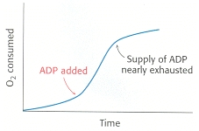
Regulation of ETC Efficiency
Primary regulator of the ETC is energy demand (ADP/ATP ratio)

Slide 31
Inefficient Coupling of the ETC
Are there any reasons why you may want to have inefficient coupling of the electron transport chain?

Slide 32
Brown Adipose Tissue and Thermogenesis

Slide 33

Mitochondria Animation

